Slide 1
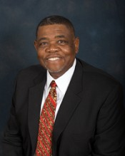
SPIRITUAL FOUNDATIONS OF AFRICAN METHODISM
DENNIS C. DICKERSON, PH.D.
JAMES M. LAWSON, JR.
PROFESSOR OF HISTORY
VANDERBILT UNIVERSITY
RETIRED GENERAL OFFICER
AME CHURCH
CONVO XVII
ATLANTA, GEORGIA
DECEMBER 3, 2015

Slide 2
AME BELIEF:
25 ARTICLES OF RELIGION
1. THE HOLY TRINITY
2. INCARNATE CHRIST
3. RESURRECTION OF CHRIST
4.THE HOLY GHOST
5. SUFFICIENCY OF SCRIPTURE FOR SALVATION
6. AUTHORITY OF THE HEBREW BIBLE
7. ORIGINAL SIN
8. FREE WILL
9. JUSTIFICATION BY FAITH

Slide 3
AME BELIEF:
25 ARTICLES OF RELIGION (CONT.)
10.GOOD WORKS
11. WORKS OF SUPEREROGATION
12. SIN AFTER JUSTIFICATION
13. THE CHURCH
14. THE FICTION OF PURGATORY
15. WORSHIP IN AN UNDERSTANDABLE
LANGUAGE
16. THE SACRAMENTS

Slide 4
AME BELIEF:
25 ARTICLES OF RELIGION (CONT.)
17. BAPTISM
18. THE EUCHARIST
19. COMMUNION IS AVAILABLE TO ALL
BELIEVERS
20. FINISHED WORK OF THE CROSS
21. MARRIAGE OF CLERGY
22. RITES AND CEREMONIES OF THE CHURCH
23. LAWS OF THE UNITED STATES
24. CHRISTIANS SHARE THEIR GOODS WITH ALL
25. OATHS

Slide 5
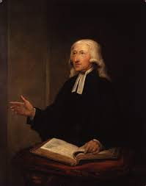
AME BELIEF:
THE WESLEYAN FOUNDATION
THE SALVIFIC PROCESS
1. SALVATION
2. SANCTIFICATION
3. PERFECTIONISM
JOHN WESLEY

Slide 6
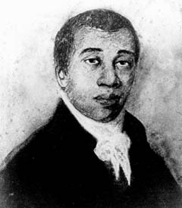
ALLEN’S SALVIFIC EXPERIENCE: SCRIPTURE
“AND, BEHOLD, THE ANGEL
OF THE LORD CAME UPON
HIM. AND A LIGHT SHINED
IN THE PRISON: AND SMOTE
PETER ON THE SIDE, AND
RAISED HIM UP, SAYING,
ARISE UP QUICKLY, AND HIS
CHAINS FELL OFF FROM HIS
HANDS.” ACTS 12:7 (KJV)

Slide 7
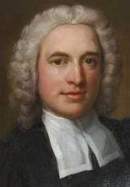
ALLEN’S SALVIFIC EXPERIENCE: HYMNODY
AND CAN IT BE (1738)
LONG MY IMPRISONED SPIRIT
LAY, FAST BOUND IN SIN AND
NATURE’S NIGHT; THINE EYE
DIFFUSED A QUICKENING RAY-
I WOKE, THE DUNGEON FLAMED WITH
LIGHT; MY CHAINS FELL OFF, MY HEART WAS
FREE, I ROSE WENT FORTH, AND FOLLOWED THEE.”
CHARLES WESLEY

Slide 8
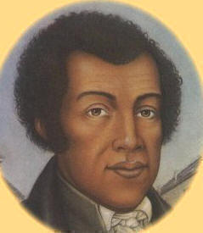
ALLEN’S SALVIFIC EXPERIENCE-TESTIMONY
“MY CHAINS FELL OFF,
MY HEART WAS FREE”
English soldier (1743)
“MY DUNGEON SHOOK…
AND MY CHAINS FLEW OFF”
Richard Allen (1777)

Slide 9
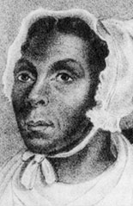
JARENA LEE’S SALVIFIC EXPERIENCE
“…the progress of the soul from a state of darkness, or of nature, was three-fold…as follows: First, conviction for sin. Second, justification from sin. Third, the entire sanctification of the soul of God. I thought this description was
beautiful and (I) immediately
believed in it”

Slide 10
JARENA LEE’S SALVIFIC EXPERIENCE (CONTINUED)
“’LORD SANCTIFY MY SOUL FOR CHRIST’S SAKE.’ THAT VERY INSTANT, AS IF LIGHTNING HAD DARTED THROUGH ME, I SPRANG TO MY FEET, AND CRIED, ‘THE LORD HAS SANCTIFIED MY SOUL!’”

Slide 11
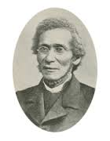
AME BELIEF:
OUR THEOLOGY
GOD OUR FATHER, CHRIST OUR REDEEMER, MAN OUR BROTHER (1856)
GOD OUR FATHER, CHRIST OUR
REDEEMER, THE HOLY GHOST
OUR COMFORTER, MAN OUR
BROTHER (1908 GENERAL CONFERENCE)

Slide 12
AME BELIEF:
OUR HISTORY
“God prepared Moses to lead Israel out of Egypt, so he lead Richard Allen, and established the AME Church. First-to demonstrate to the world the capacity of the Negro race variety for self-government and intellectual development. Second-to carry the Gospel to the emancipated Freedmen of the South. Third-to redeem Africa, our fatherland.”
Walter Thompson, “The Missionary Work of the AME Church, as it Relates to Africa,” AME CHURCH REVIEW 20 (1) (1903), 58-59.

Slide 13
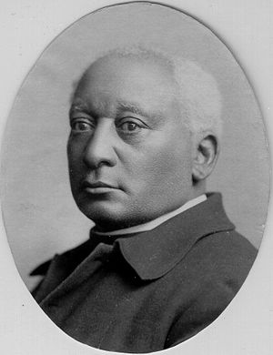
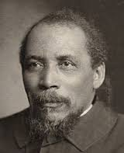
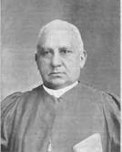
AME BELIEF: “ETHIOPIAN MILLENNIALISM”
1. BENJAMIN ARNETT, “THE NEGRO AND CHRISTIANITY,” (1893)
2. BENJAMIN T. TANNER, THE COLOR OF
SOLOMON-WHAT? (1895)
3. HENRY M. TURNER, “GOD IS
A NEGRO,” (1898)

Slide 14
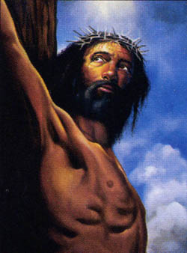
THE GREAT COMMISSION
“AND HE SAID UNTO THEM,
GO YE INTO ALL THE WORLD,
AND PREACH THE GOSPEL
TO EVERY CREATURE”
MARK 16:15 (KJV)

Slide 15
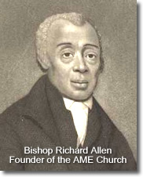
THE GREAT COMMISSION:RICHARD ALLEN
YE MINISTERS THAT ARE
CALLED IN PREACHING,
TEACHERS AND EXHORTERS
TOO. AWAKE! BEHOLD YOUR
HARVEST WASTING. ARISE!
THERE IS NO REST FOR YOU

Slide 16
THE GREAT COMMISSION: JARENA LEE
In 1835, I traveled 721 miles,
And preached 692 sermons
…In 1836, I traveled 556 miles
And preached 111 sermons. In
Philadelphia, New York, Baltimore,
and all the principal cities, from
100 to 1000 miles distant…I have
Been instrumental in the hands of
God…by raising societies where there
never had been any…

Slide 17
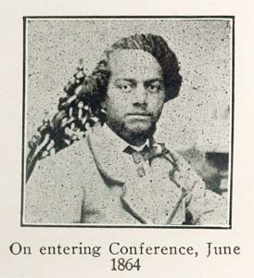
THE GREAT COMMISSION:
THEOPHILUS G. STEWARD
“I SEEK MY BRETHREN” GENESIS 37:10 (KJV)
“We have come to seek those
who are our brethren by virtue
of race; not because we care
anything for races or nations,
but because they have been
and are yet in a great measure
our brethren in affliction. And
that very affliction has served

Slide 18
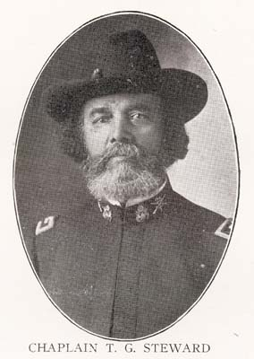
THE GREAT COMMISSION:
THEOPHILUS G. STEWARD (CONT.)
to bind us together by the
two-fold cord –sympathy,
for the oppressed, and love
of man.”
“Yet earnestly do I seek you
to tell of Jesus who was born
in Bethlehem of Judea, lived
a life of misery and discomfort,
taken by wicked hands,

Slide 19
THE GREAT COMMISSION:
THEOPHILUS G. STEWARD (CONT.)
crucified on Calvary’s top
to purchase for all men,
redemption from the
consequences of sin;
deliverance from the power
thereof; a right to the joys of
heaven, and actual indwelling
peace with God while living in
this world.”
SERMON: BEAUFORT, SC.
JUNE 18, 1865

Slide 20
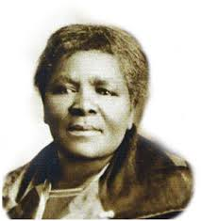
THE GREAT COMMISSION:
CHARLOTTE MANYE
Manye’s letter to
her uncle, M.M.
Mokone, founder
of the Ethiopian
Church in South Africa,
moved him to unite with
the AME Church in 1896.

Slide 21
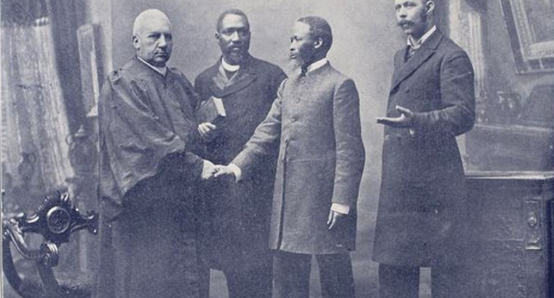
THE GREAT COMMISSION:
AFRICAN METHODISM IN SOUTH AFRICA

Slide 22
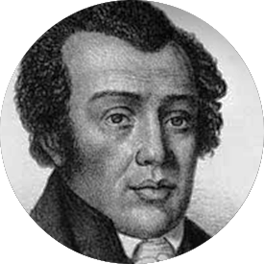
CLEARER UNDERSTANDING
OF RELATION TO JESUS
TESTIMONY OF RICHARD
ALLEN, A SLAVE
“I obtained mercy through the
blood of Christ. . .My soul was
filled I cried, enough for me-
the Saviour died.”
Jesus came to save all, irrespective of
race and with no recognition of one’s
servile status……………

Slide 23
CLEARER UNDERSTANDING OF
RELATION TO JESUS
TESTIMONY OF JARENA
LEE, A BLACK WOMAN
“If a man may preach, because the
Saviour died for him, why not the
woman? seeing he died for her also.
Is he not a whole Saviour, instead of a
half one? as those who hold it wrong for
a woman to preach, would seem to make it appear.”
Preaching a whole Saviour, without reference to race and gender, was foundational in AME Christology

Slide 24
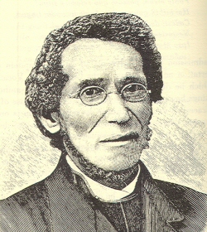
CLEARER UNDERSTANDING OF
RELATION TO JESUS
TESTIMONY OF DANIEL A.
PAYNE
“CHRIST OUR REDEEMER”
A WHOLE CHRIST, AN INCLUSIVE CHRIST,
A LIBERATIONIST CHRIST DECLARED
AS A REBUKE TO HUMAN SUBJUGATION

Slide 25
GROUNDED FAITH
The Salvific Process, as described in Wesleyan theology, involves both spiritual/scriptural holiness (personal renewal) and social holiness (societal renewal).
A. Spiritual/Scriptural holiness (personal renewal) activates in the believer the experience of salvation (deliverance from sin), sanctification (expelling from the believer the sin nature), and perfectionism (renewal that remakes the believer into the image of Christ). This is a Trinitarian transaction in which God whose grace and gift of Jesus Christ provides salvation and the Holy Ghost who takes away from the believer the sin nature and perfects the believer toward the image of Jesus Christ.

Slide 26
GROUNDED FAITH
THE SALVIFIC PROCESS (CONTINUED)
B. Social holiness (societal renewal) draws from the divine overflow from the salvific process. The same renewal that occurs within the believer and releases him/her from personal sin is similarly sought for the unrighteous and unholy surroundings in which the believer resides. Just as personal sin is repugnant to the believer, so is social sin found in slavery, segregation, apartheid, economic inequality and exploitation, hunger, and human trafficking unacceptable to those who are saved, sanctified, and “groping” toward perfection.”

Slide 27
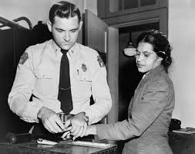
GROUNDED FAITH
ROSA PARKS EMBODIED
SPIRITUAL/SCRIPTURAL
HOLINESS SPILLING OVER
INTO PURSUITS OF SOCIAL
HOLINESS. THIS TRANSFER
THIS STEWARDESS FROM
ACTS OF SPIRITUAL/
SCRIPTURAL HOLINESS INTO
SOCIAL HOLINESS.

Slide 28
GROUNDED FAITH
INVITATION TO DISCUSS
1. Restore “sanctification” and “perfection” to the religious vocabulary of AMEs.
2. Restore the linkage between spiritual/scriptural holiness and social holiness to AME vocabulary. Also, stress the spiritual disciplines that undergird social holiness. These are pursued through the “means of grace” in such devotional venues as prayer, Bible study, participation in the sacraments, and acts of charity aimed at social reconstruction.
3. Revisit the AME creedal statement: God Our Father, Christ Our Redeemer, the Holy Spirit Our Comforter, Humankind Our Family-define its meaning and direct it twoard missional objectives.

Slide 29
GROUNDED FAITH
INVITATION TO DISCUSSION
4. Just as the General Conference of 2000 because of Bishop Robert Thomas, Jr. sacralized Sister Rosa Parks in the collect for the consecration of deaconesses, other sainted women should be added to the roster: Sister Flora Allen, known for her “piety, charity and other christian virtues” (see obituary) and Sister Sarah Allen, whose home was a station on the Underground Railroad where “the poor, flying slave, trembling and panting in his flight” found refuge.

Slide 30
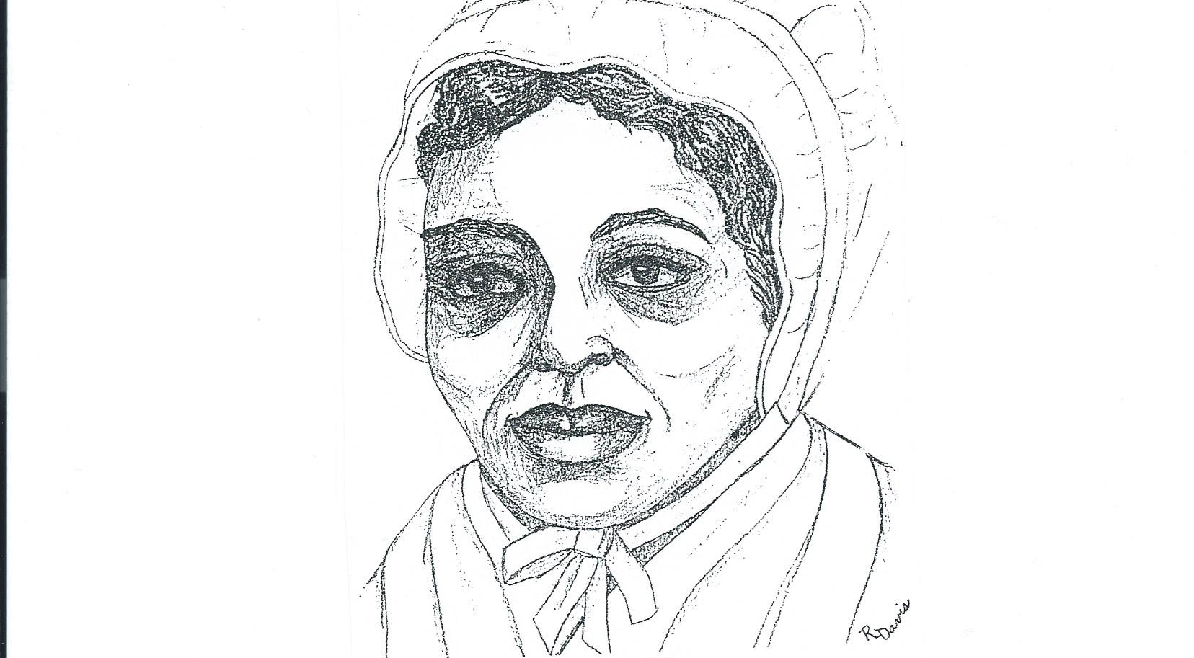
GROUNDED FAITH: SISTER FLORA ALLEN

Slide 31
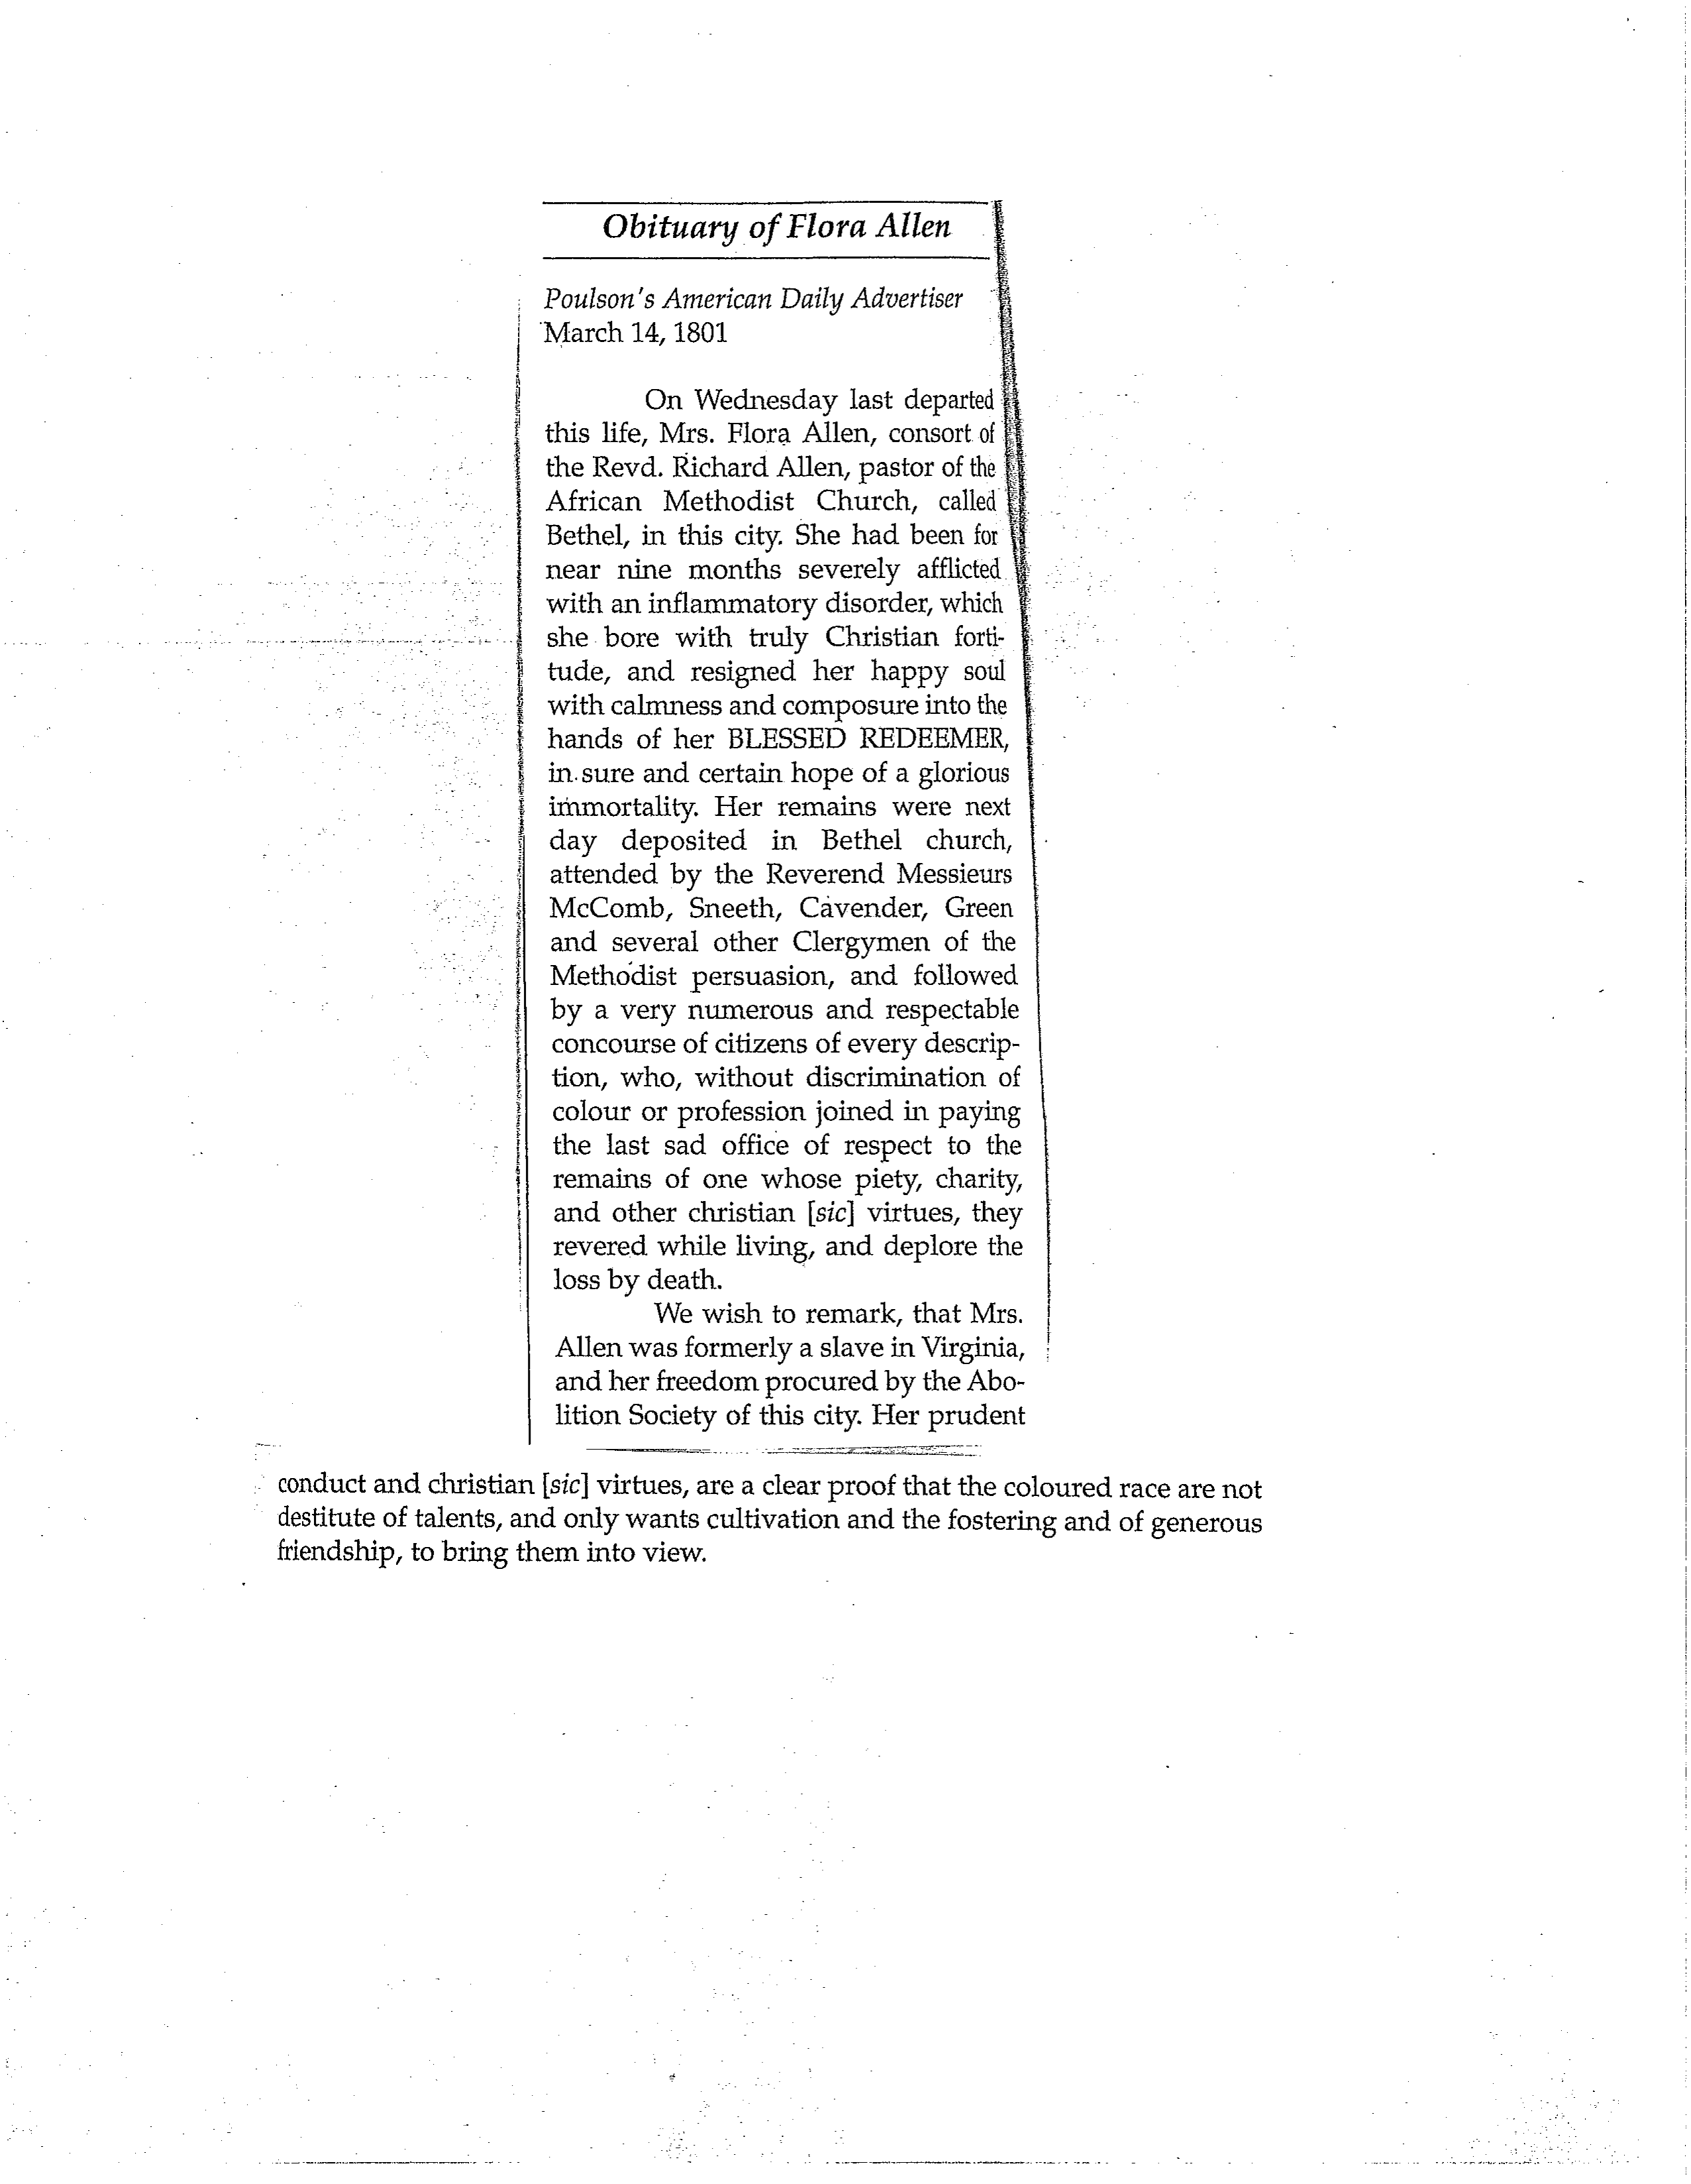
GROUNDED FAITH: FLORA ALLEN OBITUARY EXCERPT

Slide 32
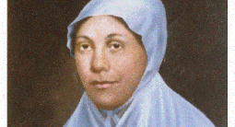
GROUNDED FAITH: SISTER SARAH ALLEN

Slide 33
GROUNDED FAITH
INVITATION TO DISCUSSION
5. Posthumous ordination of Jarena Lee as an itinerant elder

